Slide 1

JUMBLEE
TEAM MEMBERS DETAILS:
Anshika Saxena
Himanshu Bisht
Nikhil Kumar
Manasvi Gaur
Shivam Kumar Pathak
Ratan Priyanshu

Slide 2
DESCRIPTION:
Jumblee letters just what you needed
“JUMBLEE” is a puzzle theme based game in which you will be given jumbled letters and you need to guess the word meanwhile if you get stuck you can also take help through hint option
*For all ages

Slide 3
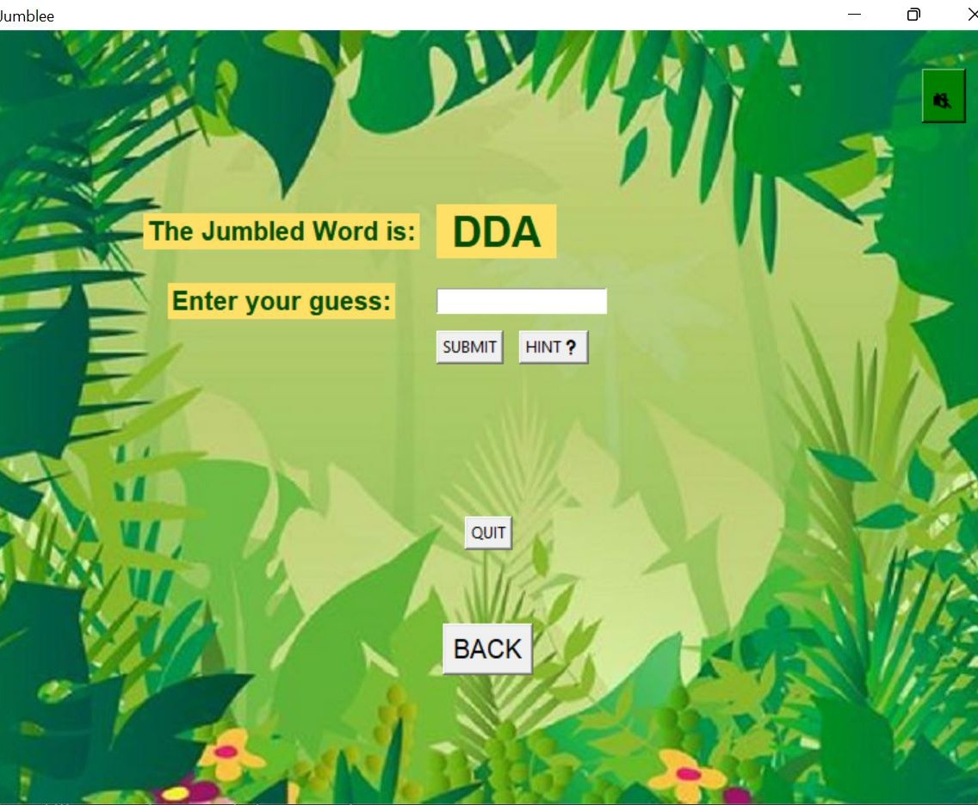

TECH STACKS:
This game is built with the help of Python language, and GUI is built with the help of Tkinter library.
We have four fundamental windows:
Login, Home, Game screen and Scoreboard.
You can also take help through Hint button.

Slide 4

SCOREBOARD
Something that curbs you from making mistake is the scoreboard. We added score as per your guess moves.
If you'll guess the correct word you will get 10 points.
On taking hint you will end up losing 1 point. For every wrong guess you will lose 3 points.
And for leaving the game you need QUIT.
**To make the game more interesting we put the limitation maximum 3 hints only**
At the end you will get the overall score.

Slide 5
INDIVIDUAL'S CONTIBUTION
Himanshu Bisht- logic building as well as major portion of the coding part in python language has been done by him.
Anshika Saxena – project leader as well as played the role of logic building work in the project. Also all the submission work done by her.
Manasvi Gaur – work related to graphical user interface has been done by her.
Shivam Kumar Pathak - all the designing work and layout of the project has been drawn by him.
Nikhil Kumar- logic building as well as major portion of the coding part in python language has been done by him as well.
Ratan Priyanshu- work related to graphical user interface has been done by him too and he also added different kind of music to different
buttons.

Slide 6
ABOUT:
Word Jumble is one of the most popular and challenging games that will test, not only
your vocabulary, but also your spelling skills.
All you have to do is rearrange a group of
letters that are in complete disorder to form the correct word, or set of words. Dust off
your dictionary and thesaurus, take up the
challenge.

Slide 7
ACKNOWLEDGEMENT
We’d like to thanks to our teachers who supported in completing the project -
Mr Sachin Vaishnav, Dr Gitika, Dr Shweta,
Dr Sumit, Mr Siddhant Poddar, Mr Tanishq Agarwal, Dr Manikandan, Dr Divya Kumari, Mr Harshvardhan Aditya, Dr Jagendra, Dr Shubhangi Rastogi and Dr Riti Kushwaha.

